Slide 1
Computer Processor
Instructor: Dr. Sukomal Pal
(Adapted from Computer Organization and Design: The Hardware/Software interface, 5th Edition, Patterson &
Hennessy)

Slide 2
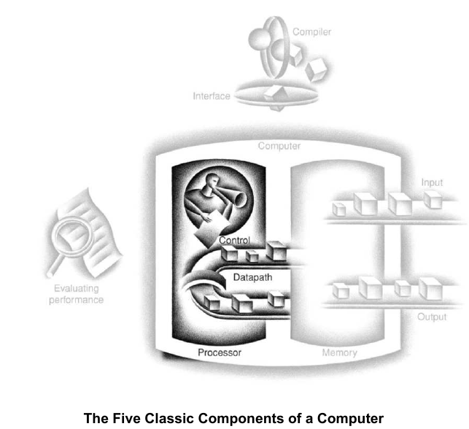
The Processor: Datapath and
Control

Slide 3
Implementing MIPS
We're ready to look at an implementation of the MIPS instruction set
Simplified to contain only
  arithmetic-logic instructions: add, sub, and, or, slt
  memory-reference instructions: lw, sw
  control-flow instructions: beq, j
6 bits
5 bits
5 bits
5 bits
5 bits
6 bits
op
rs
rt
rd
shamt
funct
R-Format
6 bits
5 bits
5 bits
16 bits
op
rs
rt
offset
I-Format
6 bits
26 bits
J-Format
op
address

Slide 4
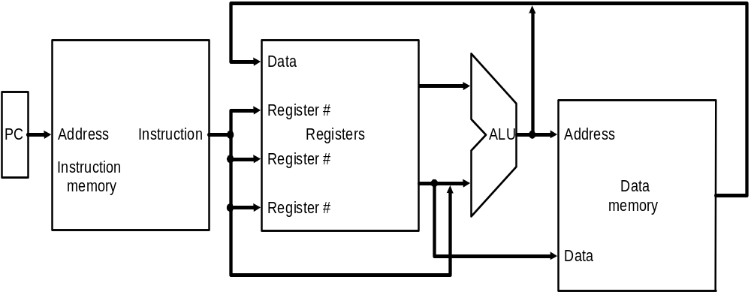
Implementing MIPS: the Fetch/Execute Cycle
High-level abstract view of fetch/execute implementation
  use the program counter (PC) to read instruction address
  fetch the instruction from memory and increment PC (FETCH)
  use fields of the instruction to select registers to read (DECODE)
  execute depending on the instruction (EXECUTE)
  repeat…

Slide 5
Overview: Processor Implementation Styles
Single Cycle
  perform each instruction in 1 clock cycle
  clock cycle must be long enough for slowest instruction; therefore,
  disadvantage: only as fast as slowest instruction
Multi-Cycle
  break fetch/execute cycle into multiple steps
  perform 1 step in each clock cycle
  advantage: each instruction uses only as many cycles as it needs
Pipelined
  execute each instruction in multiple steps
  perform 1 step / instruction in each clock cycle
  process multiple instructions in parallel – assembly line

Slide 6
Functional Elements
Two types of functional elements in the hardware:
  elements that operate on data (called combinational elements)
  elements that contain data (called state or sequential elements)

Slide 7

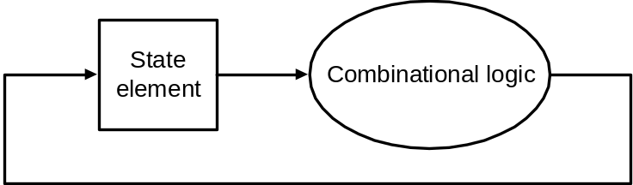
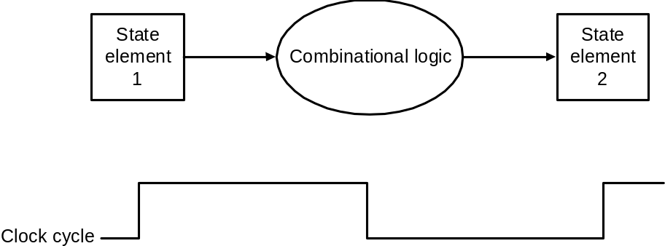
Combinational Elements
Works as an input ⇒ output function, e.g., ALU
Combinational logic reads input data from one register and writes output data to another, or same, register
  read/write happens in a single cycle – combinational element cannot store data from one cycle to a future one
Combinational logic hardware units

Slide 8
State Elements
State elements contain data in internal storage, e.g., registers and memory
All state elements together define the state of the machine
  What does this mean? Think of shutting down and starting up again…
Flipflops and latches are 1-bit state elements, equivalently, they are 1-bit memories
The output(s) of a flipflop or latch always depends on the bit value stored, i.e., its state, and can be called 1/0 or high/low or true/false
The input to a flipflop or latch can change its state depending on whether it is clocked or not…

Slide 9
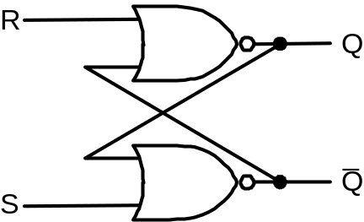
Set-Reset (SR-) latch
(unclocked)
A set-reset latch made from two cross-coupled
nand gates is a basic memory unit.
When both Sbar and Rbar are 1, then either one
of the following two states is stable:
Q = 1 & Qbar = 0
Q = 0 & Qbar = 1
and the latch will continue in the current stable
state.
If Sbar changes to 0 (while Rbar remains at 1),
then the latch is forced to the exactly one
possible stable state (a). If Rbar changes to 0
(while Sbar remains at 1), the latch is forced to
the exactly one possible stable state (b).
So, the latch remembers which of Sbar or Rbar
was last 0 during the time they are both 1.
When both Sbar and Rbar are 0 the exactly one
stable state is Q = Qbar = 1. However, if after
that both Sbar and Rbar return to 1, the latch must
then jump non-deterministically to one of stable
states (a) or (b), which is undesirable behavior.
Think of Sbar as S, the inverse of set (which
sets Q to 1), and Rbar as R, the inverse of reset.
Sbar(set)
n1
Q
Rbar
(reset)
n2
Qbar
See sr_latch.v in Verilog Examples
equivalently with nor gates

Slide 10
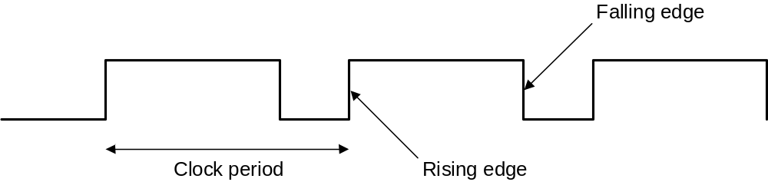
Synchronous Logic:
Clocked Latches and Flipflops
Clocks are used in synchronous logic to determine when a state element is to be updated
  in level-triggered clocking methodology either the state changes only when the clock is high or only when it is low (technology-dependent)
  I
  - in edge-triggered clocking methodology either the rising edge or falling edge is active (depending on technology) – i.e., states change only on rising edges or only on falling edge
Latches are level-triggered
Flipflops are edge-triggered

Slide 11
Clocked SR-latch
State can change only when clock is high
Potential problem : both inputs Sbar = 0 & Rbar = 0 will cause non-deterministic behavior
Sbar
X
r1
n1
Q
clk
a
clkbar
Rbar
r2
n2
Qbar
Y
See clockedSr_latch.v in Verilog Examples

Slide 12
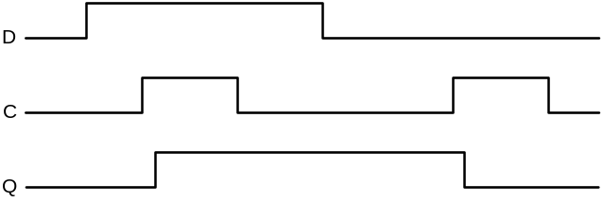
Clocked D-latch
State can change only when clock is high
Only single data input (compare SR-latch)
No problem with non-deterministic behavior
D
a2
Dbar
X
r1
n1
Q
clk
clkbar
a1
r2
n2
Qbar
Y
See clockedD_latch.v in Verilog Examples
Timing diagram of D-latch

Slide 13
Clocked D-flipflop
Negative edge-triggered
Made from three SR-latches
sbar
clear
cbar
s
q
clkbar
clk
r
qbar
rbar
d
See edge_dffGates.v in Verilog Examples

Slide 14
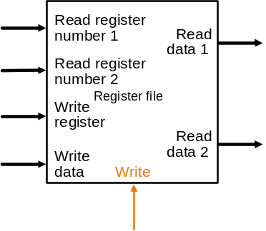
State Elements on the Datapath: Register File
Registers are implemented with arrays of D-flipflops
Clock
5 bits
32 bits
5 bits
5 bits
32 bits
32 bits
Control signal
Register file with two read ports and
one write port

Slide 15
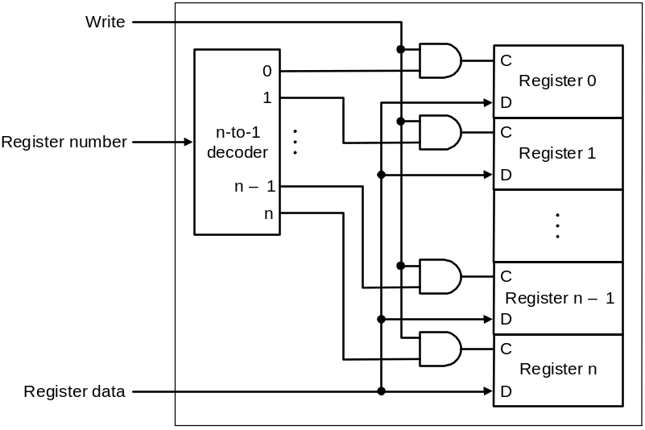
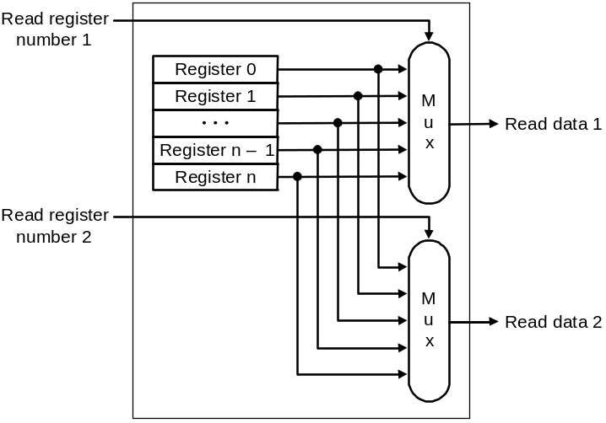
State Elements on the Datapath: Register File
Port implementation:
Clock
Clock
Read ports are implemented
with a pair of multiplexors – 5
bit multiplexors for 32 registers
Write port is implemented using
a decoder – 5-to-32 decoder for
32 registers. Clock is relevant to
write as register state may change
only at clock edge

Slide 16
Verilog
All components that we have discussed – and shall discuss – can be fabricated using Verilog
Refer to our Verilog slides and examples

Slide 17
Single-cycle Implementation of MIPS
Our first implementation of MIPS will use a single long clock cycle for every instruction
Every instruction begins on one up (or, down) clock edge and ends on the next up (or, down) clock edge
This approach is not practical as it is much slower than a multicycle implementation where different instruction classes can take different numbers of cycles
  in a single-cycle implementation every instruction must take the same amount of time as the slowest instruction
  in a multicycle implementation this problem is avoided by allowing quicker instructions to use fewer cycles
Even though the single-cycle approach is not practical it is simple and useful to understand first
Note : we shall implement jump at the very end

Slide 18
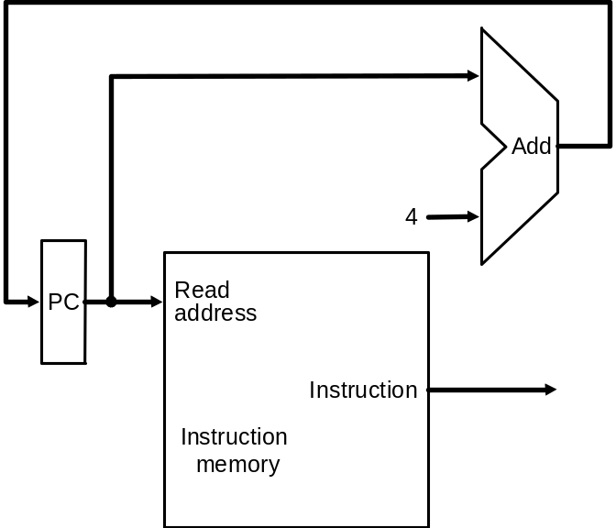
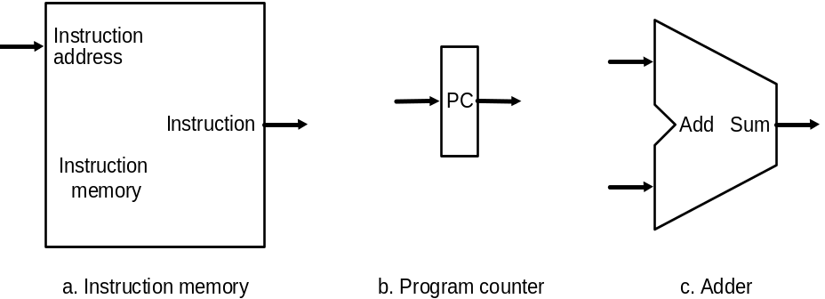
Datapath: Instruction Store/Fetch & PC Increment
Three elements used to store
and fetch instructions and
increment the PC
Datapath

Slide 19
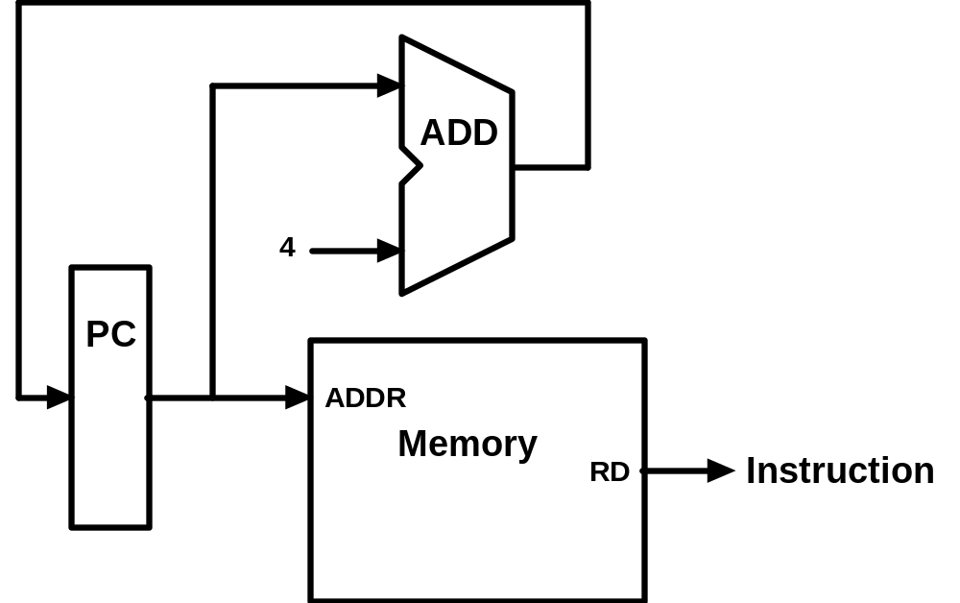
Animating the Datapath
Instruction <- MEM[PC]
PC <- PC + 4

Slide 20
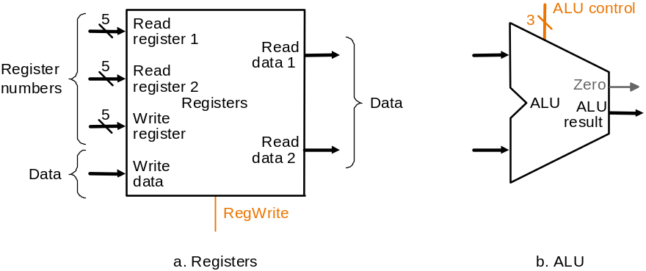
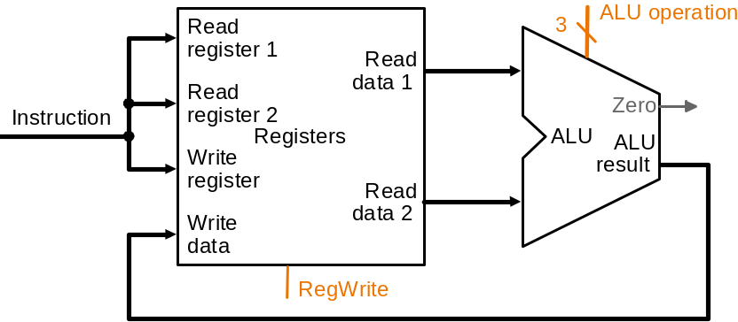
Datapath: R-Type Instruction
Two elements used to implement
R-type instructions
Datapath

Slide 21
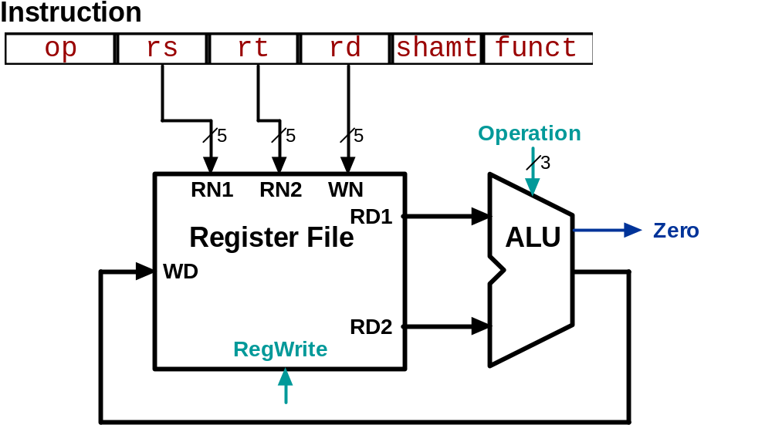
Animating the Datapath
add rd, rs, rt
R[rd] <- R[rs] + R[rt];

Slide 22
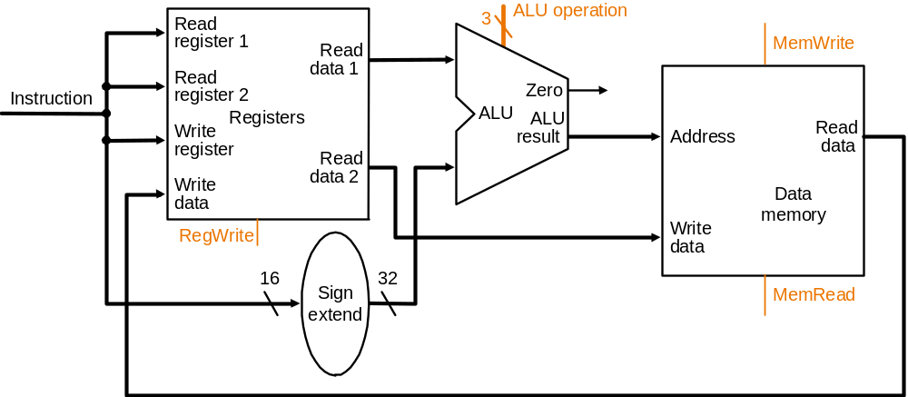
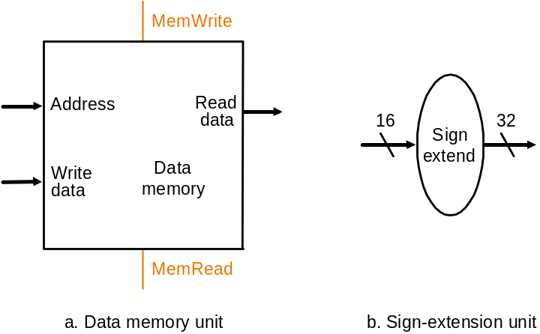
Datapath:
Load/Store Instruction
Two additional elements used
To implement load/stores
Datapath

Slide 23
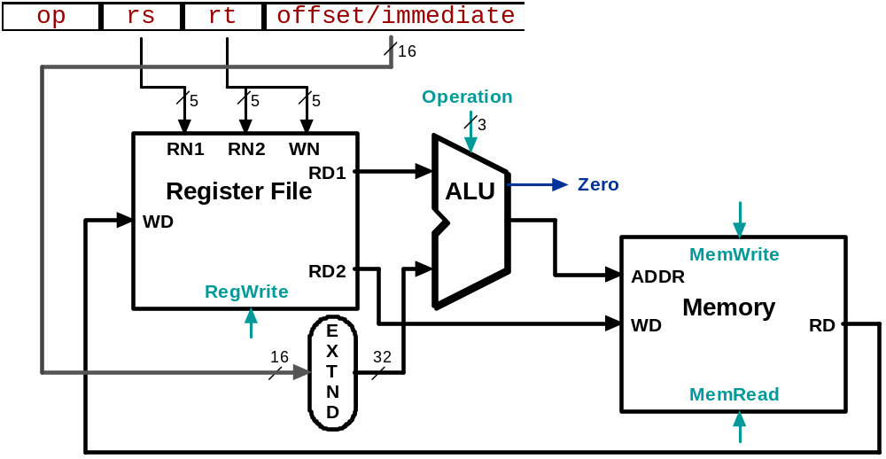
Animating the Datapath
lw rt, offset(rs)
R[rt] <- MEM[R[rs] + s_extend(offset)];

Slide 24
Animating the Datapath
sw rt, offset(rs)
MEM[R[rs] + sign_extend(offset)] <- R[rt]

Slide 25
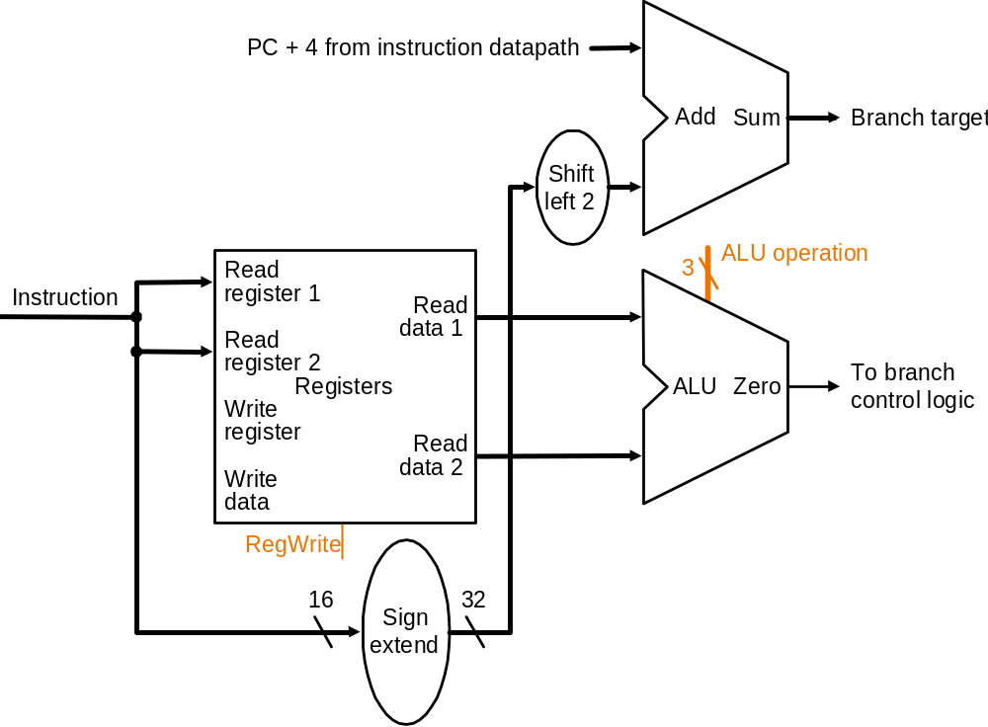
Datapath: Branch Instruction
No shift hardware required:
simply connect wires from
input to output, each shifted
left 2 bits
Datapath

Slide 26
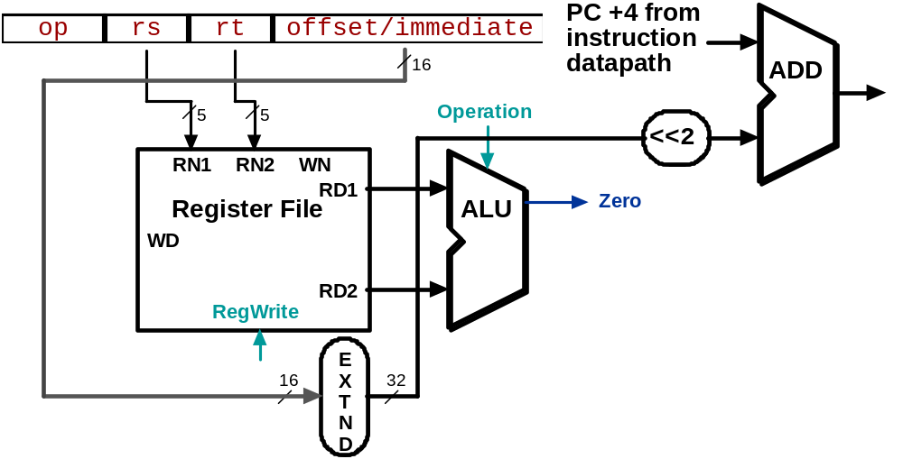
Animating the Datapath
beq rs, rt, offset
  if (R[rs] == R[rt]) then
  PC <- PC+4 + s_extend(offset<<2)

Slide 27
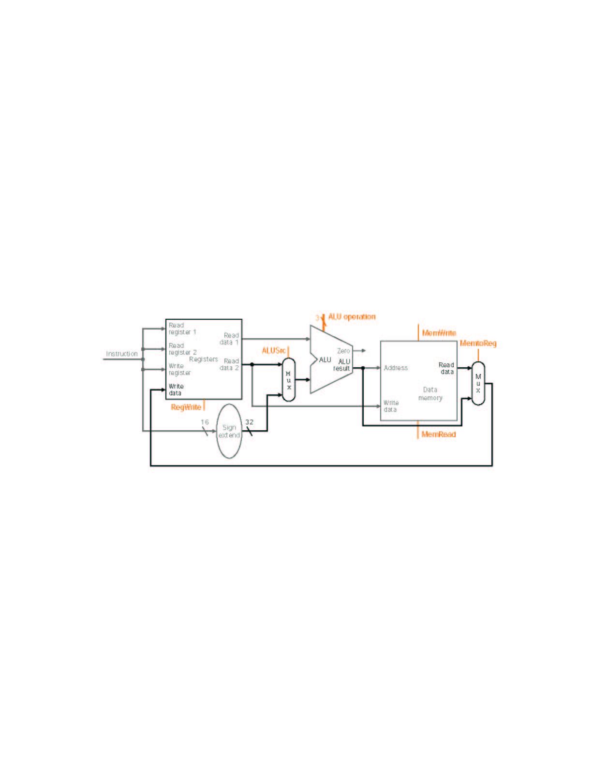
MIPS Datapath I: Single-Cycle
Input is either register (R-type) or sign-extended
lower half of instruction (load/store)
Data is either
from ALU (R-type)
or memory (load)
Combining the datapaths for R-type instructions
and load/stores using two multiplexors

Slide 28
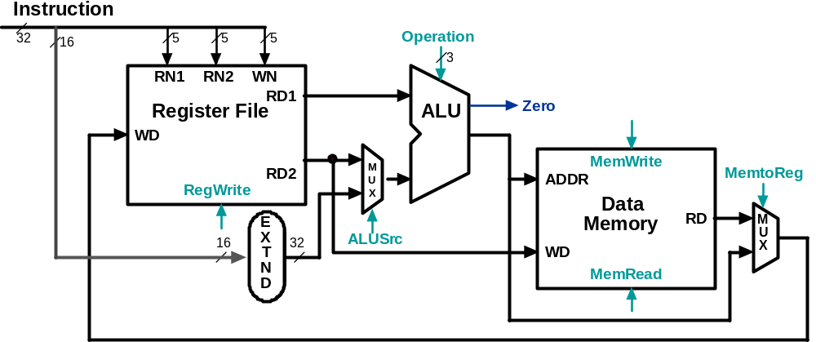
Animating the Datapath:
R-type Instruction
add rd,rs,rt

Slide 29
Animating the Datapath:
Load Instruction
lw rt,offset(rs)

Slide 30
Animating the Datapath:
Store Instruction
sw rt,offset(rs)

Slide 31
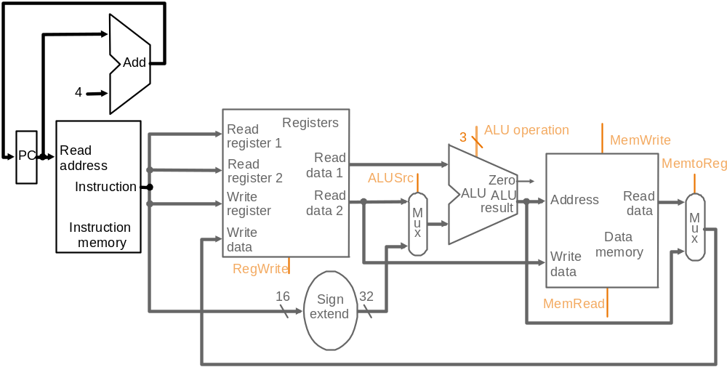
MIPS Datapath II: Single-Cycle
Separate adder as ALU operations and PC
increment occur in the same clock cycle
Separate instruction memory
as instruction and data read
occur in the same clock cycle
Adding instruction fetch

Slide 32
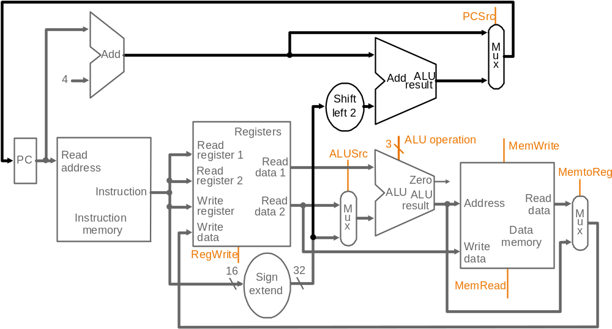
MIPS Datapath III: Single-Cycle
Extra adder needed as both
adders operate in each cycle
New multiplexor
Instruction address is either
PC+4 or branch target address
Adding branch capability and another multiplexor
Important note: in a single-cycle implementation data cannot be stored during an instruction – it only moves through combinational logic
Question: is the MemRead signal really needed?! Think of RegWrite…!

Slide 33
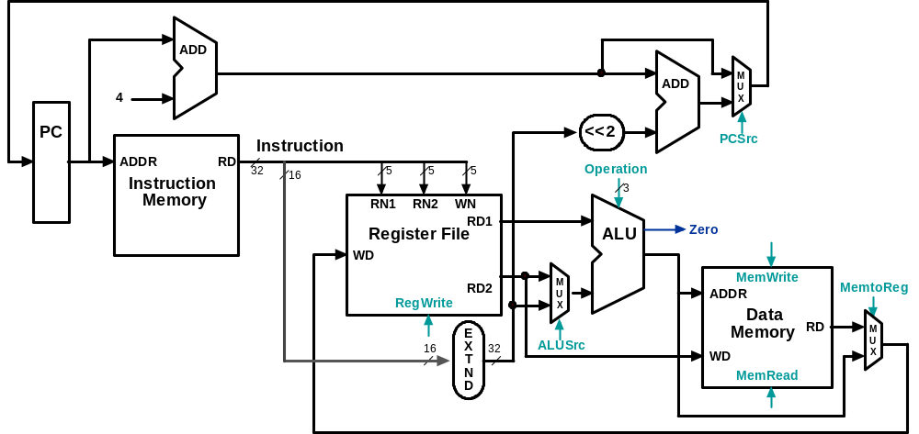
Datapath Executing add
add rd, rs, rt

Slide 34
Datapath Executing lw
lw rt,offset(rs)

Slide 35
Datapath Executing sw
sw rt,offset(rs)

Slide 36
Datapath Executing beq
beq r1,r2,offset

Slide 37
Control
Control unit takes input from
  the instruction opcode bits
Control unit generates
  ALU control input
  write enable (possibly, read enable also) signals for each storage element
  selector controls for each multiplexor

Slide 38
ALU Control
Plan to control ALU: main control sends a 2-bit ALUOp control field to the ALU control. Based on ALUOp and funct field of instruction the ALU control generates the 3-bit ALU control field
ALU control Func-
  field tion
000 and
001 or
010 add
110 sub
111 slt
2
3
To
ALU
Main
Control
ALUOp
ALU
Control
ALU
control
input
6
Instruction
funct field
ALU must perform
- add for load/stores (ALUOp 00)
- sub for branches (ALUOp 01)
- one of and, or, add, sub, slt for R-type instructions, depending on the
instruction’s 6-bit funct field (ALUOp 10)
ALUOp generation
by main control

Slide 39
Setting ALU Control Bits
Instruction AluOp Instruction Funct Field Desired ALU control
opcode operation ALU action input
LW 00 load word xxxxxx add 010
SW 00 store word xxxxxx add 010
Branch eq 01 branch eq xxxxxx subtract 110
R-type 10 add 100000 add 010
R-type 10 subtract 100010 subtract 110
R-type 10 AND 100100 and 000
R-type 10 OR 100101 or 001
R-type 10 set on less 101010 set on less 111
ALUOp
Funct field
Operation
ALUOp1
ALUOp0
F5
F4
F3
F2
F1
F0
0
0
X
X
X
X
X
X
010
0
1
X
X
X
X
X
X
110
1
X
X
X
0
0
0
0
010
1
X
X
X
0
0
1
0
110
1
X
X
X
0
1
0
0
000
1
X
X
X
0
1
0
1
001
1
X
X
X
1
0
1
0
111
Truth table for ALU control bits

Slide 40
Designing the Main Control
R-type
opcode
rs
rt
rd
shamt
funct
31-26
25-21
20-16
15-11
10-6
5-0
Load/store
or branch
opcode
rs
rt
address
31-26
25-21
20-16
15-0
Observations about MIPS instruction format
  opcode is always in bits 31-26
  two registers to be read are always rs (bits 25-21) and rt (bits 20-16)
  base register for load/stores is always rs (bits 25-21)
  16-bit offset for branch equal and load/store is always bits 15-0
  destination register for loads is in bits 20-16 (rt) while for R-type instructions it is in bits 15-11 (rd) (will require multiplexor to select)

Slide 41
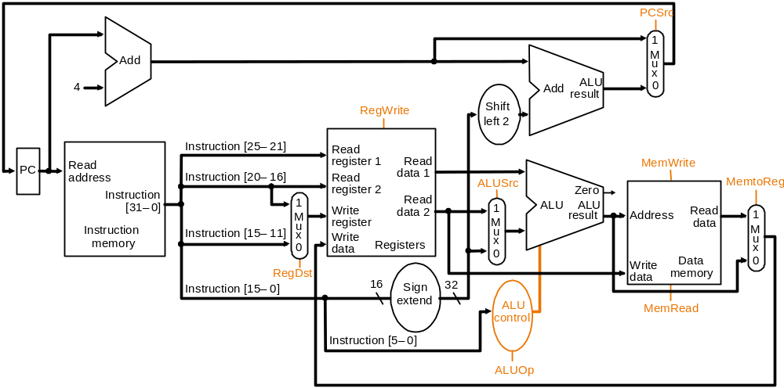
Datapath with Control I
6 bits
5 bits
5 bits
5 bits
5 bits
6 bits
op
rs
rt
rd
shamt
funct
R-Format
6 bits
5 bits
5 bits
16 bits
op
rs
rt
offset
I-Format
6 bits
26 bits
op
address
J-Format
New multiplexor
Adding control to the MIPS Datapath III (and a new multiplexor to select field
To specify destination register): what are the functions of the 9 control signals?

Slide 42
Control Signals
Signal Name Effect when deasserted Effect when asserted
RegDst The register destination number for the The register destination number for the
Write register comes from the rt field (bits 20-16) Write register comes from the rd field (bits 15-11)
RegWrite None The register on the Write register input is written
with the value on the Write data input
AlLUSrc The second ALU operand comes from the The second ALU operand is the sign-extended,
second register file output (Read data 2) lower 16 bits of the instruction
PCSrc The PC is replaced by the output of the adder The PC is replaced by the output of the adder
that computes the value of PC + 4 that computes the branch target
MemRead None Data memory contents designated by the address
input are put on the first Read data output
MemWrite None Data memory contents designated by the address
input are replaced by the value of the Write data input
MemtoReg The value fed to the register Write data input The value fed to the register Write data input
comes from the ALU comes from the data memory
Effects of the seven control signals

Slide 43
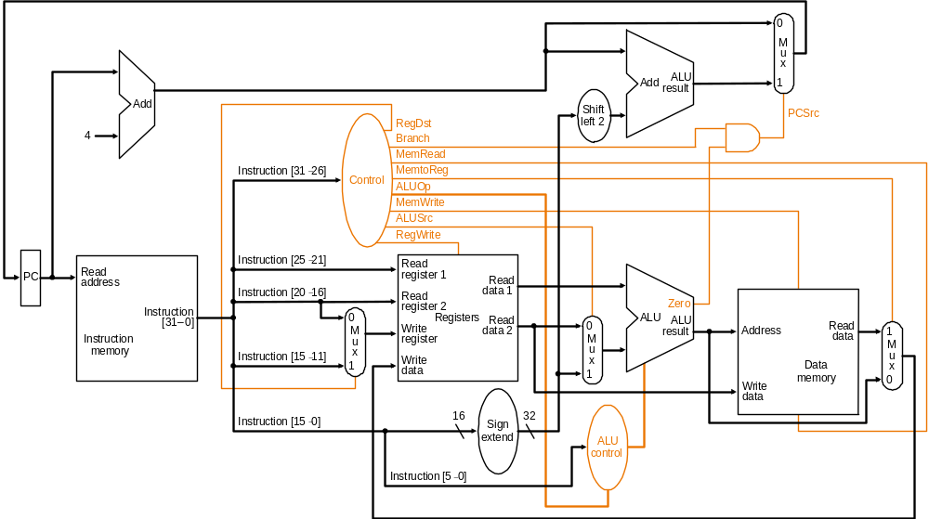
Datapath with Control II
MIPS datapath with the control unit: input to control is the 6-bit instruction
opcode field, output is seven 1-bit signals and the 2-bit ALUOp signal

Slide 44
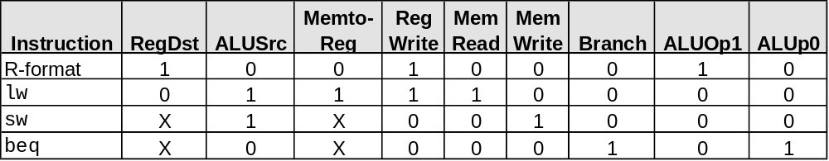
Datapath with
Control II (cont.)
PCSrc cannot be
set directly from the
opcode: zero test
outcome is required
Determining control signals for the MIPS datapath based on instruction opcode

Slide 45
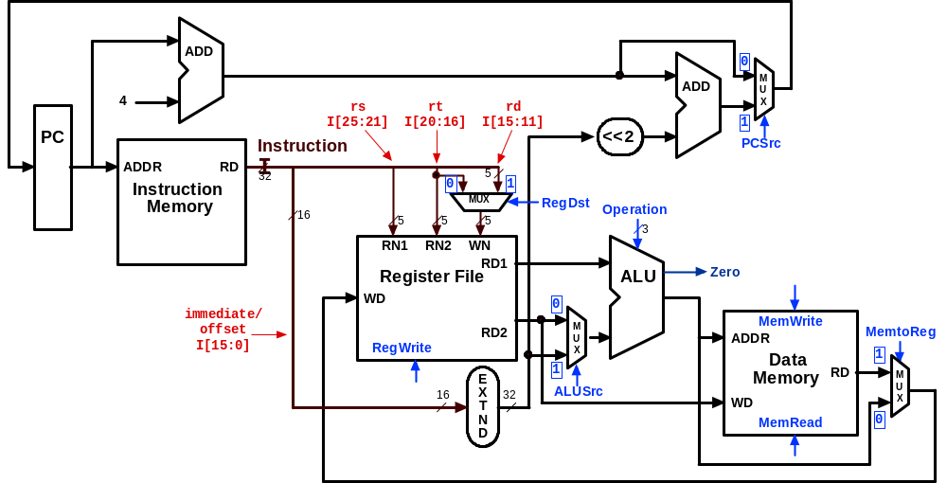
Control Signals:
R-Type Instruction
0
???
Value depends on funct
1
0
0
1
Control signals
shown in blue
0
0

Slide 46
Control Signals: lw Instruction
0
010
0
0
1
1
Control signals
shown in blue
1
1

Slide 47
Control Signals: sw Instruction
0
010
X
1
X
0
Control signals
shown in blue
1
0

Slide 48
Control Signals: beq Instruction
1 if Zero=1
110
X
0
X
0
Control signals
shown in blue
0
0

